Slide 1

Covid-19
Group Members
Asad Ali Khan
Rifat Ahmed Khan

Slide 2

Data Sources
We used 3 different Datasets in this Project:
Covid-19 Data (for each date).
Covid-19 Data(Cumulative).
International Arrivals.
All the data sets are in csv format.

Slide 3

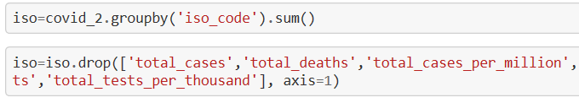
Cleaning the Data
We have applied the following methods on the data:
1
We cleaned the data by replacing the Nan values with zeros.
2
We used the groupby() and sum()functions, where the data for countries are divided into states or region.
3
We used drop() function, to drop unwanted data. And also used rename() method
4
nlargest() function is being used for selecting the required data.

Slide 4
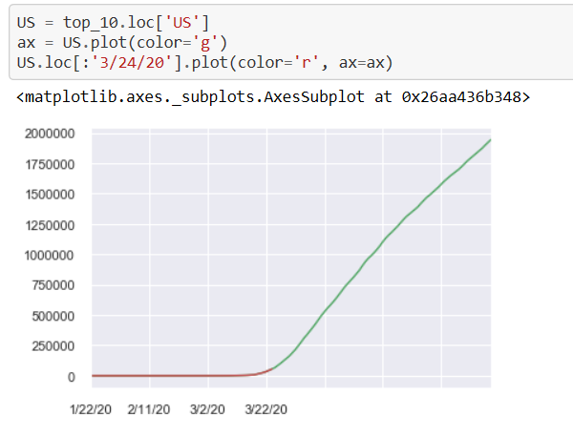
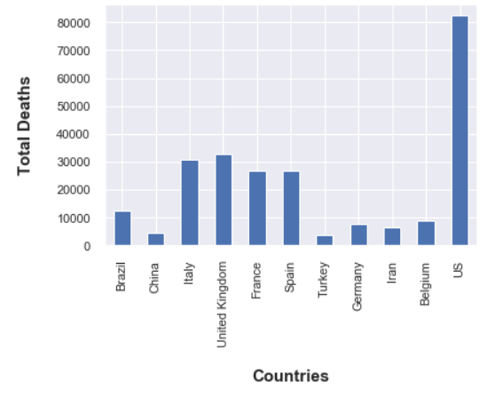
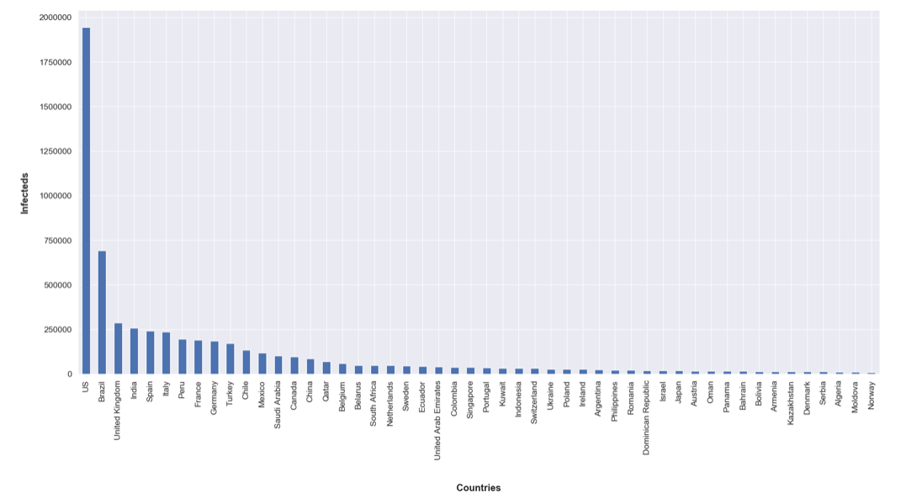
Procedures and Methods used
We have used different charts. Bar Charts, Line Graphs
1
Bar Chart is used for comparing deaths in different countries.
2
Line chart is used to show the trends.
3
Linear Regression

Slide 5
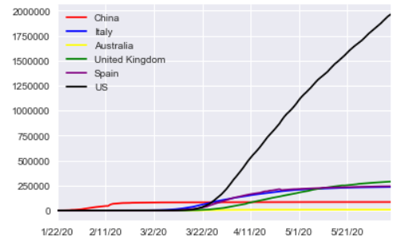
Finding the worst hit Country by Covid-19
Using the first dataset, we plotted the timeline of the number of infected for the most effected countries on the same axes in order to do a visual comparison.
Result: China had the greatest rise in the number of confirmed cases initially, the rate eventually flattened out. In the US, cases were nil initially and eventually the number reached to about 1900000 confirmed cases, being the worst hit country to date. UK has more than 250000 confirmed cases according to latest intel. Australia has the lowest number of confirmed cases among these countries to date.

Slide 6
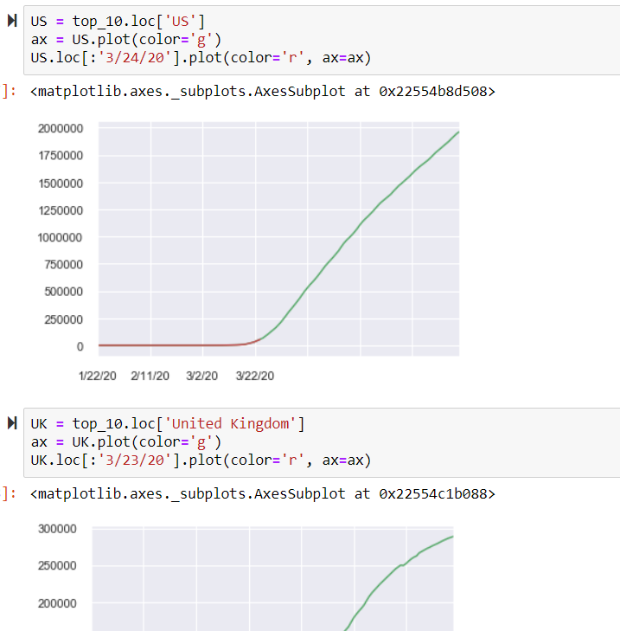
Finding the worst hit Country by Covid-19 during lockdown.
Answering this question was in steps. First, we have found the top_10 most impacted countries from Covid-19 pandemic and the reason for doing this was countries with insignificant Covid-19 cases were not going to affect the results.
For choosing the Top_10 countries we used the nlargest() function.
The variable we have chosen for predicting the worst hit Country was Total number of Cases registered during Lockdown.
We use graphs for comparing. The red part of the graphs represent the number of infecteds before lockdown and the green part represents the number of infecteds after lockdown.
Result: US is the worst effected country during the Lockdown. Only for Iran, the lockdown temporarily helped flatten the rise of infecteds for a little while. Netherlands and Belgium has the lowest number of infecteds to date. So it can be assumed that the lockdown has paid off in these countries. Though, the reason can't can be concluded for sure.

Slide 7
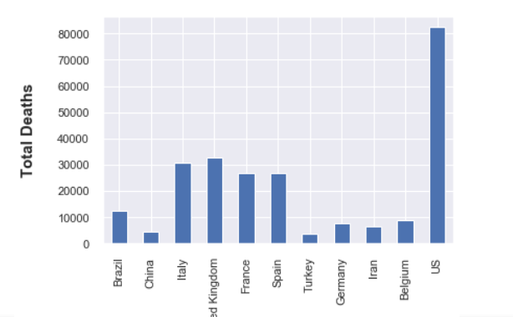
Worst death cases
Using the second dataset, we plotted a bar graph for the number of deaths of majorly hit countries on the same axes in order to do a visual comparison.
Result: US has the highest number of deaths with the total amount being more than 80000.

Slide 8
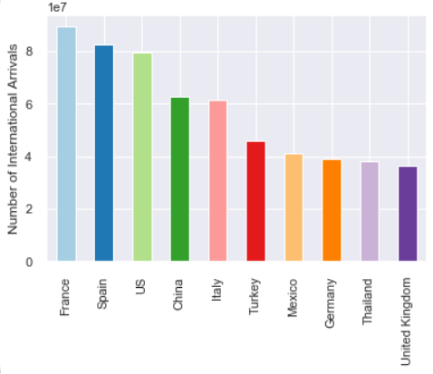
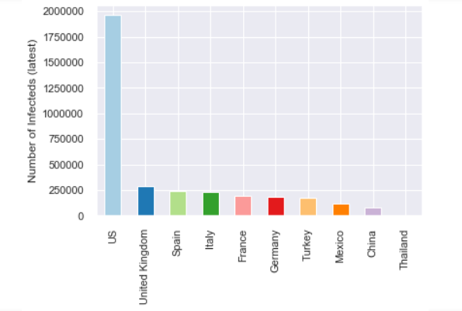
Relation between International Travel and Covid-19 Cases for the countries
1
We find the top 10 countries respective to international travels, arranged in a descending order according to international travels in a bar graph.
Then, we find the top 10 countries respective to international travels, arranged in a descending order according to the latest number of infecteds in a bar graph
2

Slide 9
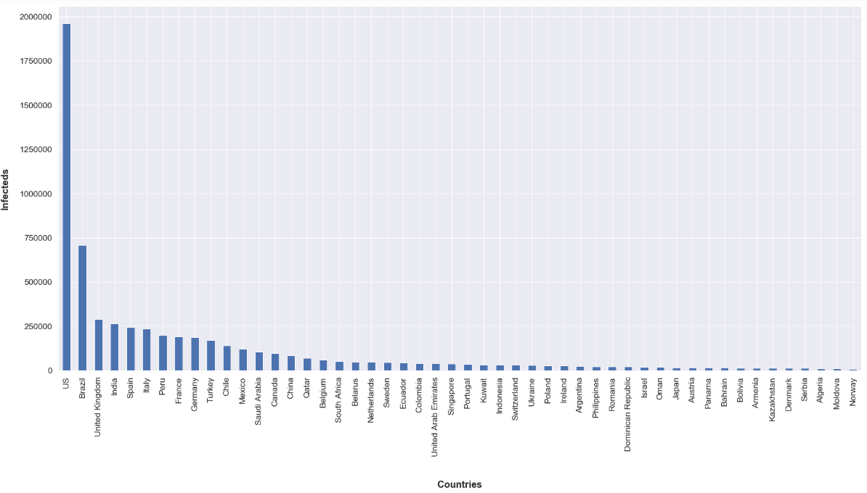
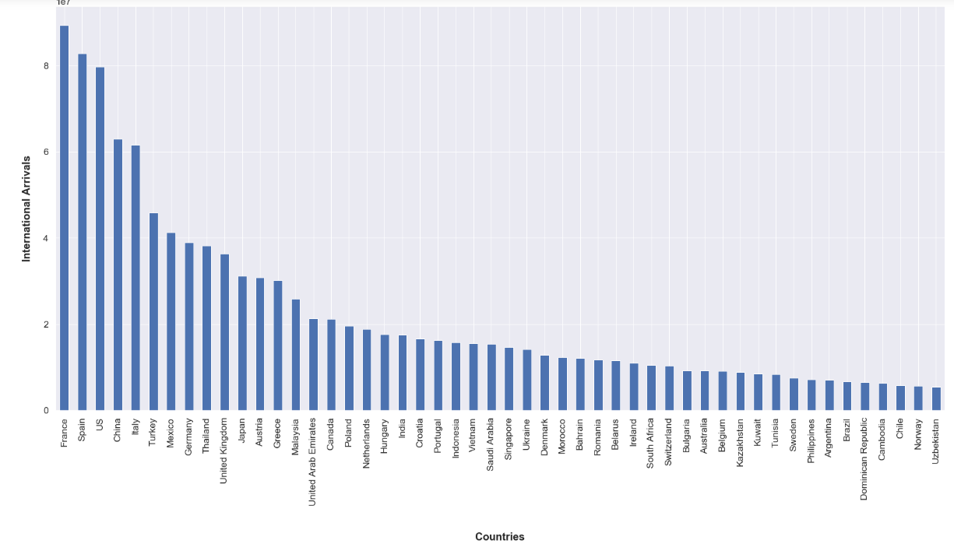
Relation between International Travel and Covid-19 Cases for the countries
3
We plotted the same graphs again for top 50 countries
4
Among the 50 countries chosen with maximum international arrivals, are common with 50 countries having maximum infecteds. This gave us a clue that there is a positive correlation between international arrivals and the risk of COVID-19 spread in a country.

Slide 10
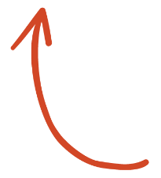
Method for Correlation between Covid-19 Cases and International arrival in countries
SELECT ME
In order to find out conclusive results about if there exists a relationship between international travel and Covid-19 cases, we need to do a Spearman rank-order correlation.

Slide 11

Relation between International Travel and Covid-19 Cases for the countries
5
Then we calculated the Spearman rank-order correlation coefficient between the two variables. This gave us a positive correlation of 0.73 (within a scale of -1 to +1) between the number of international arrivals to a country and the number of infecteds in that country. This means that the greater the number of international arrivals to a country, the greater the risk of that country of having more infecteds.

Slide 12

Travelling and Covid-19
There is a positive relationship between the Travelling and Covid-19 Spread. Countries with most International arrivals are worst hit by Covid-19. France, Spain, Italy, UK, USA, Turkey, Germany, Mexico all these countries are among the worst hit countries by the pandemic and are with the most International Arrivals.
Notes:
In Slide Show mode, select the arrows to visit links.

Slide 13
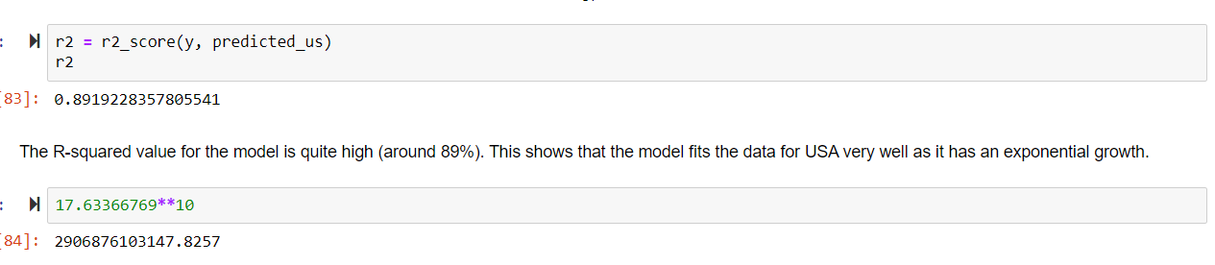
Simple Predictive Model for USA
We select the data for USA as it has a clear exponential curve and build a linear regression model to predict the log of the number of cases.
Result: The R-squared value for the model is quite high (around 89%). This shows that the model fits the data for USA very well as it has an exponential growth.
From the model, we can predict that if USA doesn't take drastic measures and come up with some sort of control to limit their spread of the COVID-19 virus, the numbers of infected in their country could eventually reach up to approximately 2906876103147 (which is more than the population of USA but it’s just a simple prediction).

